Slide 1
Skin Lesions Detection
Supervised by: Assoc Prof. Ensaf Hussein

Slide 2
Prepared by
Hossam Hassan Kamal Mostafa Hamdy Khalil Mohamed Abdallah Youssef Nada Khater Abdu
Heba Ahmed Mohamed
Mai Hamada Elsayed

Slide 3
OUTLINE
Introduction
Problem Statement
Related Work
Contribution Points
Proposed Model
Experimental Results
Conclusion & Future Work

Slide 4
01.
Introduction

Slide 5
INTRODUCTION
What is Skin Lesion?
How are Skin Lesion affecting the world?
How does Skin Lesion detected?

Slide 6
Doctors VS. Mobile App
Doctors
Mobile App
Patients have fears about whether these skin lesions are carcinogenic or not, as well as going to the doctor.
A mobile app that can detect the lesion if it is Cancer or not while you are in your home.

Slide 7
02.
Problem Statement

Slide 8
Problem Statement
Develop a Mobile App that helps users to detect Skin Lesion early.
Achieve High Accuracy by using Deep Hybrid Models.
Failure to detect the tumor in the early stages leads to the difficulty of treatment.

Slide 9
03.
Related Work

Slide 10
Related Work (Selected)
Paper Author | DataSet | Approach | Accuracy
Nan Chen & et al. (2021) | PAD-UFES-20 (IMG+Metadata) | ResNet50 | 85.5%
Nils Gessert & et al. (2019) | HAM10000 (IMG+Metadata) | CNN | 74.20%
Andre Estev & et al. (2020) | ISIC (Images only) | CNN | 93%

Slide 11
04.
Contribution Points

Slide 12
Contribution Points
Create a model which has a high accuracy level of detecting the lesion.
CHALLENGE
Deep Hybrid Model (DL + ML)
MobileNetv2 +
(Logistic Regression & Random Forest)
SOLUTION
RESULT
Achieve high accuracy 95.6% when compared to previous models.

Slide 13
05.
Proposed Model

Slide 14
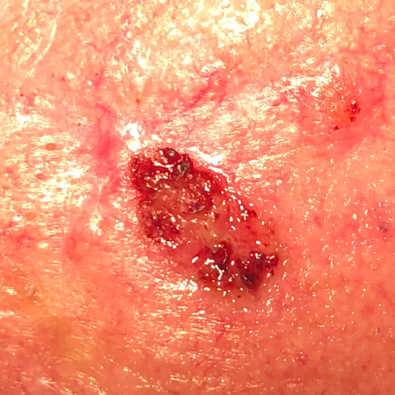
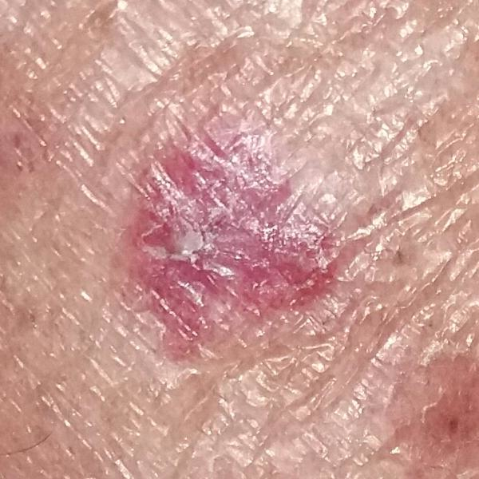
Data-Set
PAD-UFES-20:
Dataset composed of patient data and clinical images collected from smartphones.
It consists of 2298 images and 6 classes: ACK, BCC, MEL, NEV, SCC, SEK
The metadata associated with each image is composed of 26 attributes: 21 patient clinical features, 4 identifying features (patient ID, lesion ID, Image ID, and if the sample is biopsy proven), and a diagnostic label.

Slide 15
Solution Methodology
Scenario 1 79.1%
Scenario 2 82.1%
Scenario 3 85.6%
Applying 10 pre-trained models to our dataset (IMG+Meta)
Adding another 2 Dense Layers (EfficientNetB4)
Deep Hybrid Model (MobileNetv2+ML Classifier)
Scenario 4 86.9%
Scenario 5 74.7%
Scenario 6 95.6%
Concatenate Pass all features to one Machine Learning Classifier
Deep Hybrid Model (MobileNetv2+ML Classifier +Weighted Avg)
Hyper + 2 Dense Layers (The Approved Scenario)

Slide 16
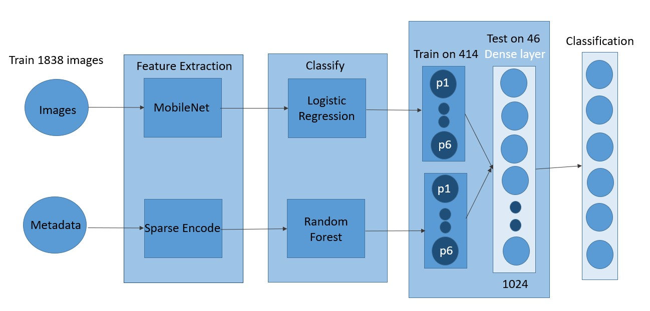
Proposed Model

Slide 17
Pre-processing
Images:
Convert the color of images to RGB.
Normalize images by dividing them into 255.
Metadata:
Categorize meta and deal with Null values.
Sparse Encode: Encode the string in the metadata.
Split Dataset into: 80% Train, 10% Validation, 10% Test.

Slide 18
The Used Hyperparameters
Factor (s) | Value (s)
Dense Layer(s) + RELU Dense Layer(s) + SoftMax Dropout Layer(s) Dropout Rate Learning Rate Epsilon Optimizers Kernel Regularizer Batch Size No. of Epochs Image Size | 1, 2 1, 2 0, 1 0.5, 0.9 0.001, 0.0001 0.01,0.001 Adam, SGD L1=1e-5, L2=1e-4 16, 32, 64 50, 100, 200 380*380, 224*224

Slide 19
06.
Experimental Results

Slide 20
Experimental Results
Model | Accuracy | Precision | Recall | F1 - Score
Deep Hybrid Model (Ours) | 95.6 % | 89 % | 91 % | 88 %
CNN (Andre Estev - 2020) | 93 % | 90 % | 89 % | 86 %
ResNet50 (Nan Chen - 2021) | 85.5 % | 88 % | 90 % | 83 %

Slide 21
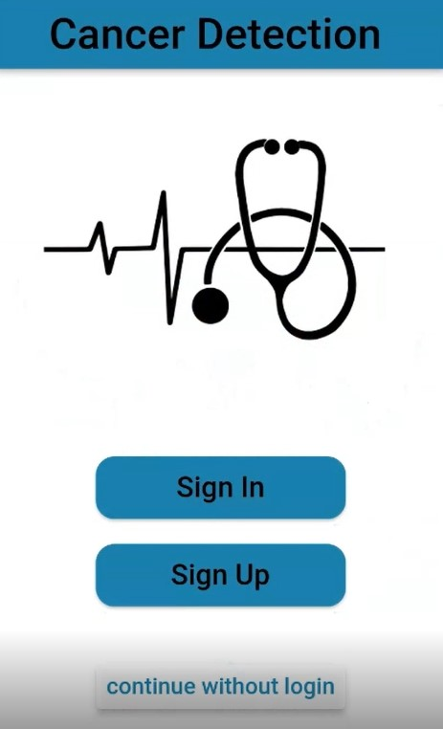
Snap Shots
Home Page

Slide 22
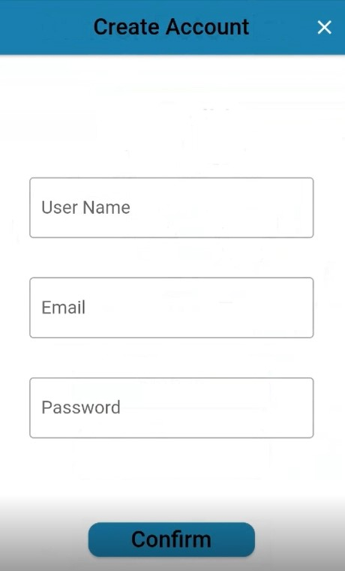
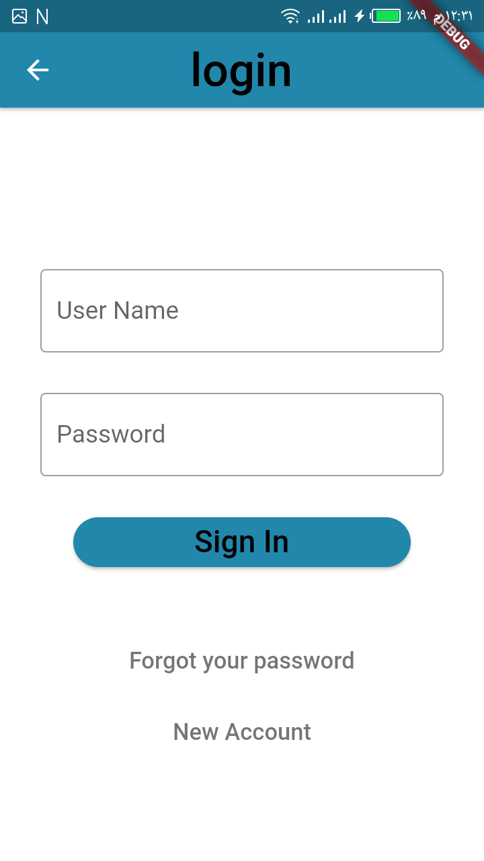
Snap Shots
Login & Register

Slide 23
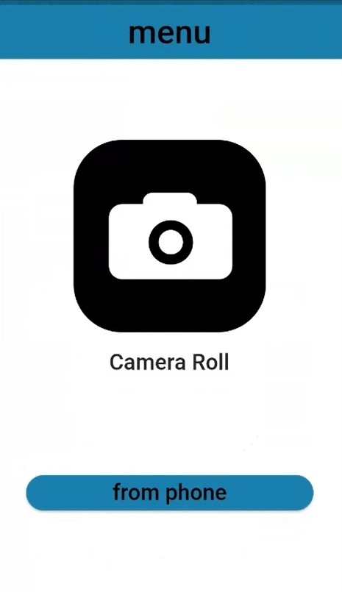
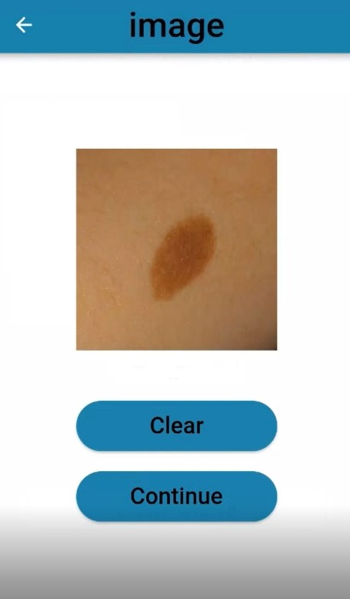
Snap Shots
App Menu Choose Image

Slide 24
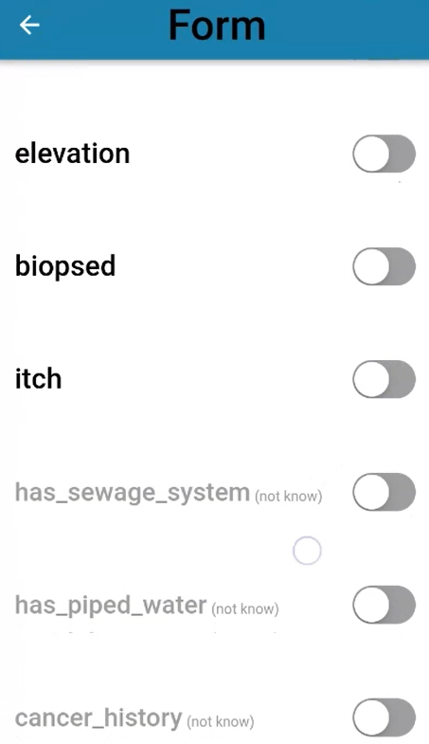
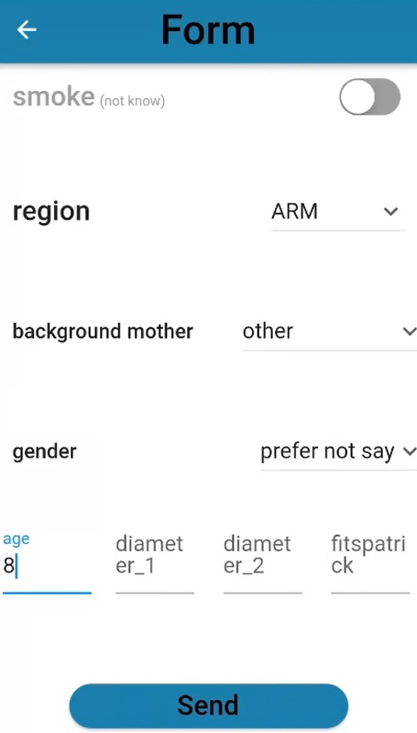
Snap Shots
Add Meta

Slide 25
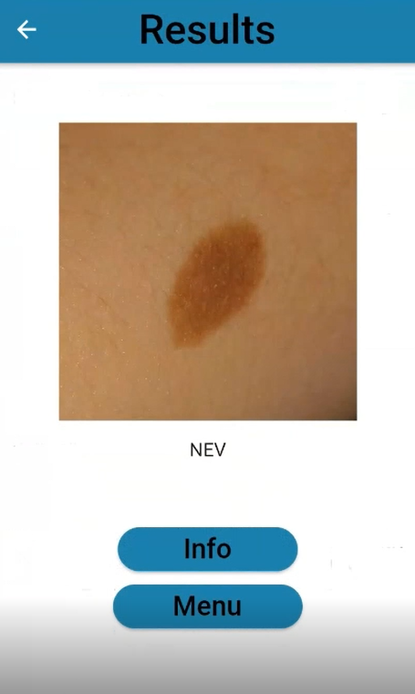
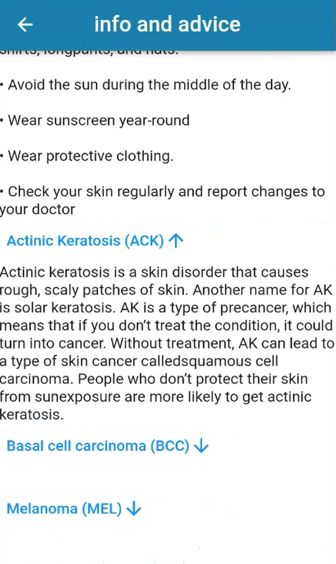
Snap Shots
Detect Lesion Info & Advice

Slide 26
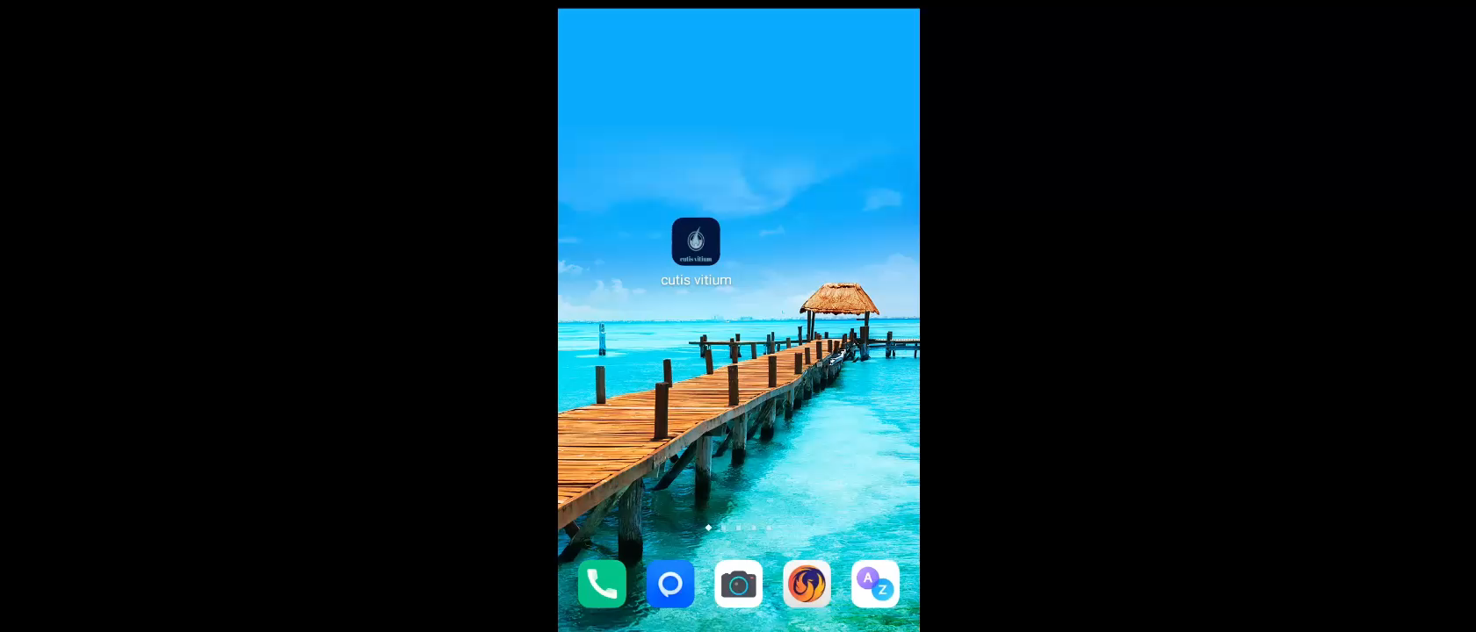
APP DEMO

Slide 27
07.
Conclusion & Future Work

Slide 28
Conclusion
MobileNetv2 showed great results compared to other pre-trained models.
For Images, the best model was Logistic Regression. Random Forest, on the other hand, was the best for Metadata.
Metadata has an impressive efficiency to our model as it made it more accurate.

Slide 29
Future Work
Dataset with different skin colors
Enhancement segmentation
Adding contact with doctor
Launch the beta version for close people and friends
Release the App

Slide 30
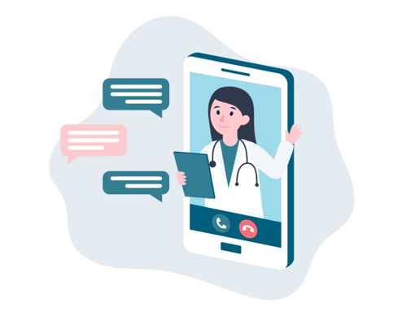
THANKS
Any Questions?

